Slide 1
Introduction to Business Analytics Classification by Income Basket based on Census Data
Group – 10 (OUTLIERS)
Derek Huang
Harry Gao
Sameera Vattikuti
Yidan Yu

Slide 2
Agenda
I. Business Understanding
II. Data Preparation
III. Modeling
IV. Evaluation
V. Deployment

Slide 3


Understanding the Need
Need:
Investment products with high return
Private banking and asset management
Need:
Access to low interest financing
Insurance products

Slide 4
Benefits from Segmentation
Improve Product Portfolio & Services
Tailored products to suite the demand of different segments
Increased attractiveness to potential customers
Improve Marketing Efficiency
Improve penetration rate of marketing materials
Optimize marketing spending

Slide 5
Business Problem Statement
To differentiate individuals that earn more than or less than the average based on annual per-capita income of USA (~$50,000 Per Annum) using demographic attributes, so that a financial institution can differentiate their marketing efforts to suit the needs of different customer segments

Slide 6
Agenda
I. Business Understanding
II. Data Understanding & Preparation
III. Modeling
IV. Evaluation
V. Deployment

Slide 7

Data Understanding
Data Description: Describes individuals’ personal background, working history, capital market performance and income
Dimensions: 48842 Rows, 15 Columns
Target Variable: income
≤ 50K: 37,155 (76.0%)
> 50K: 11,687 (24.0%)
Object: Predict whether individual’s income exceeds $50K/Yr
Sl. No. | Variable | Variable Type | Description
1 | age | Numerical | Age of the individual
2 | workclass | Categorical | Type of employer (public, private etc.)
3 | fnlwgt | Numerical | The No. of individuals the census represents
4 | education | Categorical | Highest level of education of individual
5 | rducation-num | Numerical | No. of years of education of the individual
6 | marital-status | Categorical | Marital status
7 | occupation | Categorical | Type of employment
8 | relationship | Categorical | Relationship Status
9 | race | Categorical | Race
10 | sex | Categorical | Gender
11 | capital-gain | Numerical | Capital gains of individual
12 | capital-loss | Numerical | Capital Loss of Individual
13 | hours-per-week | Numerical | No. of working hours per week
14 | native-country | Categorical | Country of origin
15 | income | Categorical | Income Bracket (> 50 K or ≤ 50K per annum)
*Source: UCI Machine Learning Repository website: https://archive.ics.uci.edu/ml/datasets/Adult

Slide 8
Data Preparation
Data Cleaning
Missing Values: 3,620 rows
Duplicated Rows: 29 rows
Dropped features:
Fnlwgt
Sl. No. | Variable | Variable Type | Actions
1 | age | Numerical
2 | workclass | Categorical | Convert to dummy variable
3 | fnlwgt | Numerical | Dropped
4 | education | Categorical | Recategorize & convert to dummy variable
5 | education-num | Numerical
6 | marital-status | Categorical | Convert to dummy variable
7 | occupation | Categorical | Convert to dummy variable
8 | relationship | Categorical | Convert to dummy variable
9 | race | Categorical | Recategorize & convert to dummy variable
10 | sex | Categorical | Convert to dummy variable
11 | capital-gain | Numerical | Combine with capital-loss
12 | capital-loss | Numerical | Combine with capital-gain
13 | hours-per-week | Numerical | Combine with capital-loss
14 | native-country | Categorical | Recategorize & convert to dummy variable
15 | income | Categorical | Convert to dummy variable
Data Transformation
Converted to Dummy Variables: 7 categorical features
Combined features
Capital-gain, capital-loss
Recategorized features
Native-country (41), education (16)

Slide 9
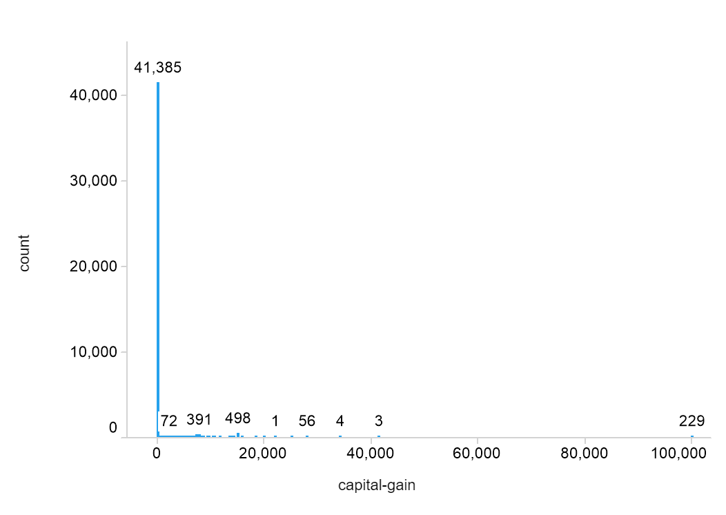
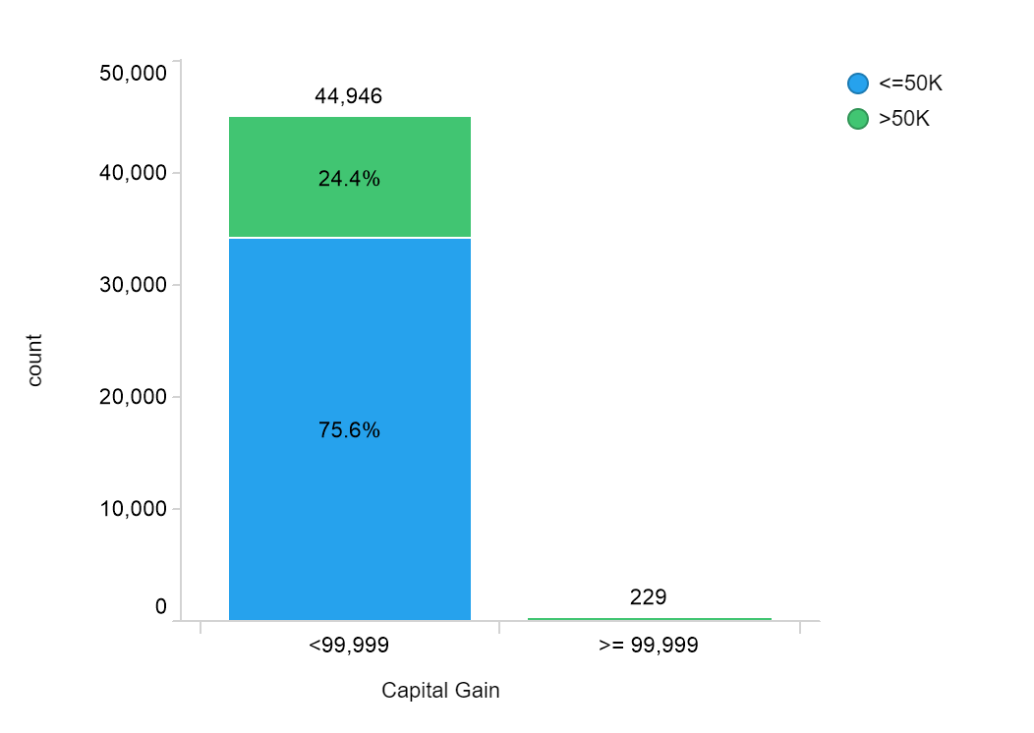
Data Preparation
Capital Gain Distribution
Income Class Distribution for Capital Gain > 60K
Actions
For people who has capital gain greater or equal than 99999, their capital gain was assigned to 99999
Through exploration, we noted that all observations with capital_gain = 99999 belongs to income >50K.
To improve our model accuracy, we have filtered the dataset to capital_gain < 99999 and build models on this final dataset.

Slide 10
Data Preparation
Dimensions: 45175 Rows, 54 Columns
Target Variable: income
≤ 50K: 33,988 (75.2%)
> 50K: 11,206 (24.8%)
Sl. No. | Variable | Variable Type | Actions
1 | age | Numerical
2 | workclass | Binomial | Convert to 6 binomial variables
3 | education | Binomial | Convert to 10 binomial variables
4 | education-num | Numerical
5 | marital-status | Binomial | Convert to 6 binomial variables
6 | occupation | Binomial | Convert to 12 binomial variables
7 | relationship | Binomial | Convert to 5 binomial variables
8 | sex | Binomial | Convert to 1 binomial variables
9 | net_capital_gain | Numerical | Combine capital gain and capital loss by sum
11 | hours-per-week | Numerical
12 | native-country | Binomial | Convert to 4 binomial variables
13 | income | Binomial | Convert to 1 binomial variables

Slide 11
Agenda
I. Business Understanding
II. Data Understanding & Preparation
III. Modeling
IV. Evaluation
V. Deployment

Slide 12
Modeling: Overview
Predicted as >50K
Net Capital gain
≥
99999
Yes
Prediction
Data
No
Classification
Model

Slide 13
Modeling: Induction Process
Model
Models
K-NN (Standardization)
Logistic Regression (RFE)
Tree Model
Feature Selection (Only for Logistic Regression)
There are 54 features in the data set before feature selection
Recursive Features Elimination is employed to select 27 features
Only applied in logistic regression
Grid Search
Tune the hyperparameters.
Cross Validation
5 folds
Score: Accuracy
=

Slide 14
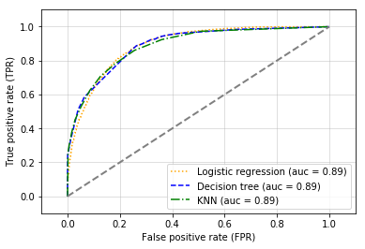
Modeling: In-Sample Performance
 | K-NN | Tree | Logistic Regression
Parameters | K: 21 Weights: uniform Leaf Size: 30 Metric: Euclidean | Criterion: gini Max depth: 7 Min samples leaf: 3 Min samples split: 2 | Regularization: 10 Fit_intercept : True Tolerance: 0.001
Accuracy | 84.6% | 85.3% | 84.4%
Stability | +/- 0.003 | +/- 0.003 | +/- 0.003
Pros | Easy to implement and use Robust Capture interactions | Easy to understand, implement, and use. Computationally cheap | Features importance Easy feature selection Probability outcome
Cons | Computation inefficiency Storage Dimensionality | Instability: sensitive to data change Complexity: easily overfit | Not flexible Require independent observations

Slide 15
Agenda
I. Business Understanding
II. Data Understanding & Preparation
III. Modeling
IV. Evaluation
V. Deployment

Slide 16
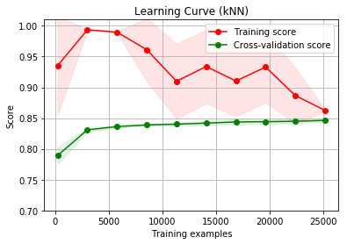
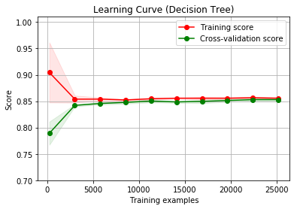
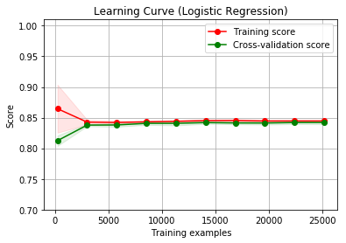
Evaluation: Learning Curve
CV score plateaus at .85
The movement of Training score shows how the model learns from the nearest neighbors included in data set with increasing number of instances
CV & Training scores converge at slightly over .85
Model overfits initially (when instances <~4000), but corrects itself as instances are added
CV & Training scores converge at .84
Model overfits initially (when instances <~4000) to a lesser extent than tree model, but corrects itself as instances are added

Slide 17
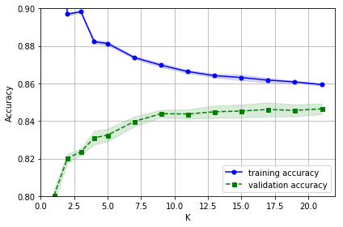
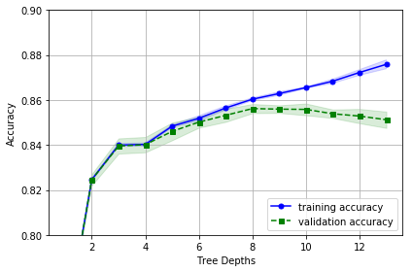
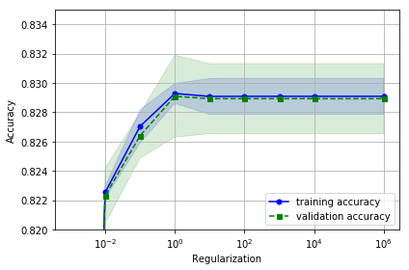
Evaluation: Fitting Graph
kNN
Decision Tree
Logistic Regression
Underfitting initially
Stabilizes as K goes up
Accuracy of both Training & CV improve till an extent
Scores start diverging at depth of around 7 like grid search’s output indicating overfitting when
Feature selection done before grid search
Half features already dropped before Grid Search. Hence no major divergence in curves after c =1

Slide 18
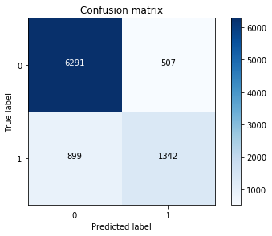
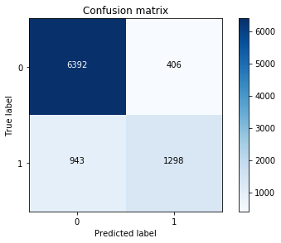

Evaluation: Confusion Matrix
kNN
Decision Tree
Logistic Regression
Out-of-Sample Accuracy: .84
Out-of-Sample F1 Score: .77
Out-of-Sample Accuracy: .85
Out-of-Sample F1 Score: .78
Out-of-Sample Accuracy: .83
Out-of-Sample F1 Score: .74
 | ≤ $50K | >$50K
Precision | .87 | .72
Recall | .93 | .59
F-Measure | .9 | .65
 | ≤ $50K | >$50K
Precision | .87 | .76
Recall | .94 | .57
F-Measure | .9 | .65
 | ≤ $50K | >$50K
Precision | .86 | .69
Recall | .93 | .52
F-Measure | .89 | .59

Slide 19

Evaluation
Best Model: Decision Tree
Higher Out-of-Sample Accuracy
Easier for business to comprehend
Computationally cheap

Slide 20
Evaluation: Business Case
Scenario for targeting an individual with income > 50K
Avg. Cost to Market to a consumer = $15
Avg. Customer Life Time value = $10,000
Random
Rate of Conversion: 1%
Expected Value:
= 85*(.5)
= $42.5
With Model
Rate of Conversion: 10%
Expected Value:
= 985*(.1436)-15*(.1043)
= $139.88
 | p | n
Y | 85 | -15
N | 0 | 0
 | p | n
Y | 985 | -15
N | 0 | 0
.5 | 0
0 | .5
.1436 | .1043
.0449 | .7072

Slide 21
Agenda
I. Business Understanding
II. Data Preparation
III. Modeling
IV. Evaluation
V. Deployment

Slide 22
Deployment of Decision Tree Model
Implementation of the model in business processes
Proper communication with business leaders
Integration of the model into marketing activities, e.g. cold calls
Extension of the model
More granular target variables
Inclusion of more attributes in the dataset
Use of probability ranking

Slide 23
Risks and Opportunities
Possible risks | Mitigation
Model goodness depends on the parameter range used | Widen the parameter range used in the model Trade-off between computational efficiency and
Disproportionate cost and benefits | Detailed cost benefit matrix based on business understanding Monitoring of other performance metrics Constant updates

Slide 24
Additional Ethical Considerations
Ethical concerns
Use of sensitive demographic data
E.g. sex, race
Acquisition of demographic data and privacy issue

Slide 25
Conclusion
Any volunteers?

Slide 26
Q&A

Slide 27
Appendix

Slide 28
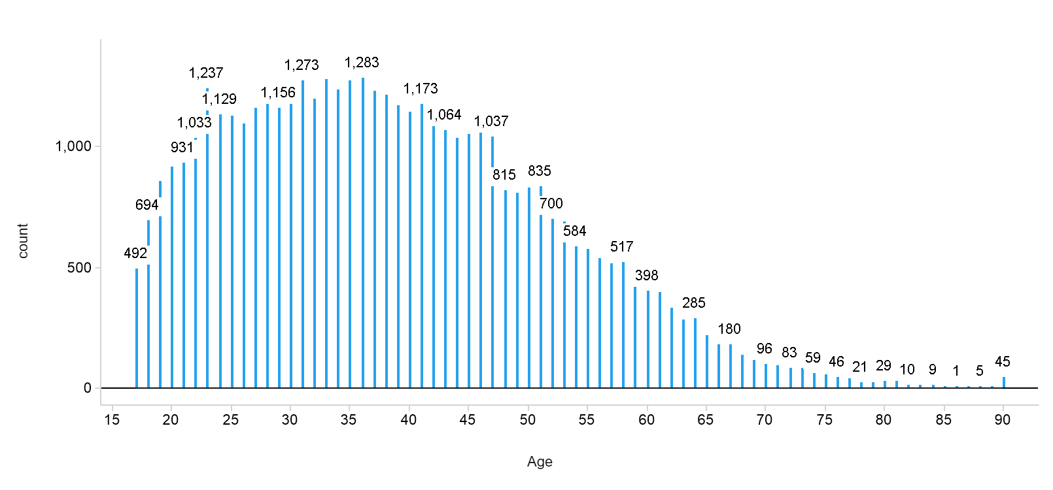
Age Distribution

Slide 29
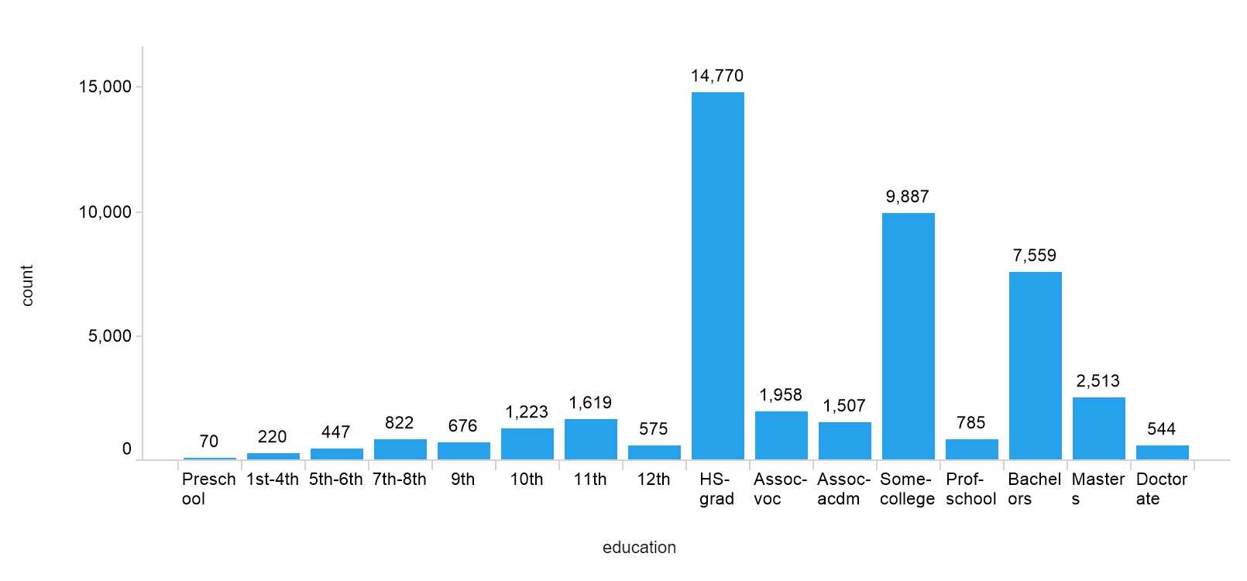
Education distribution

Slide 30
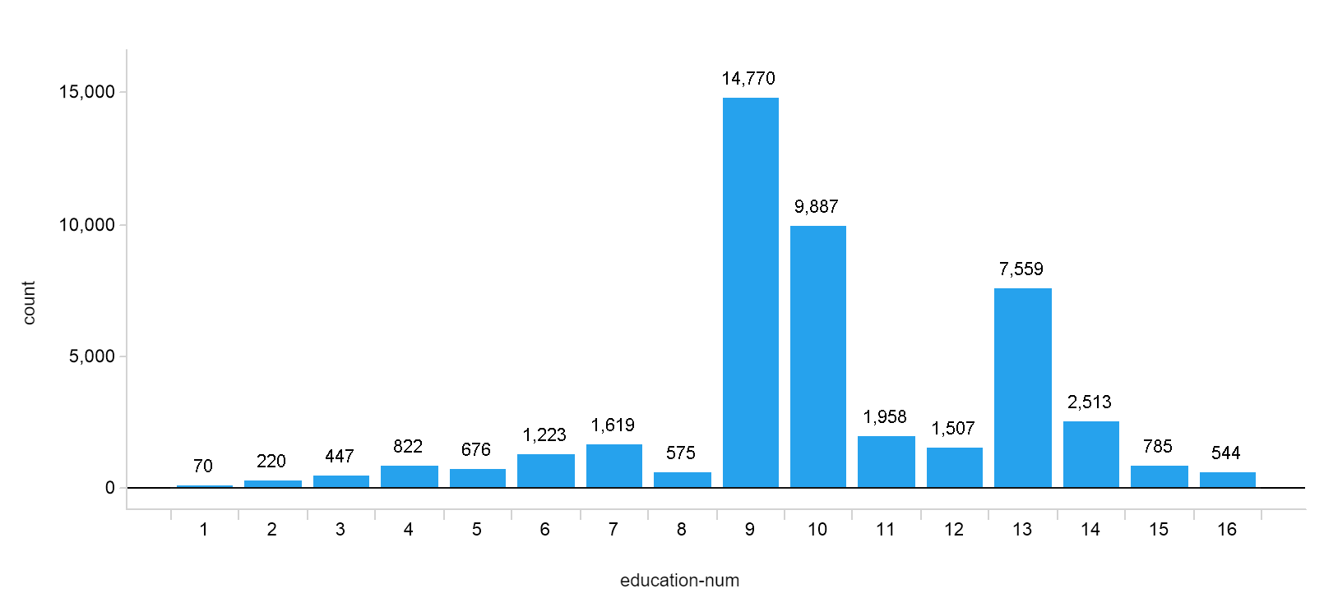
Education Number Distribution

Slide 31
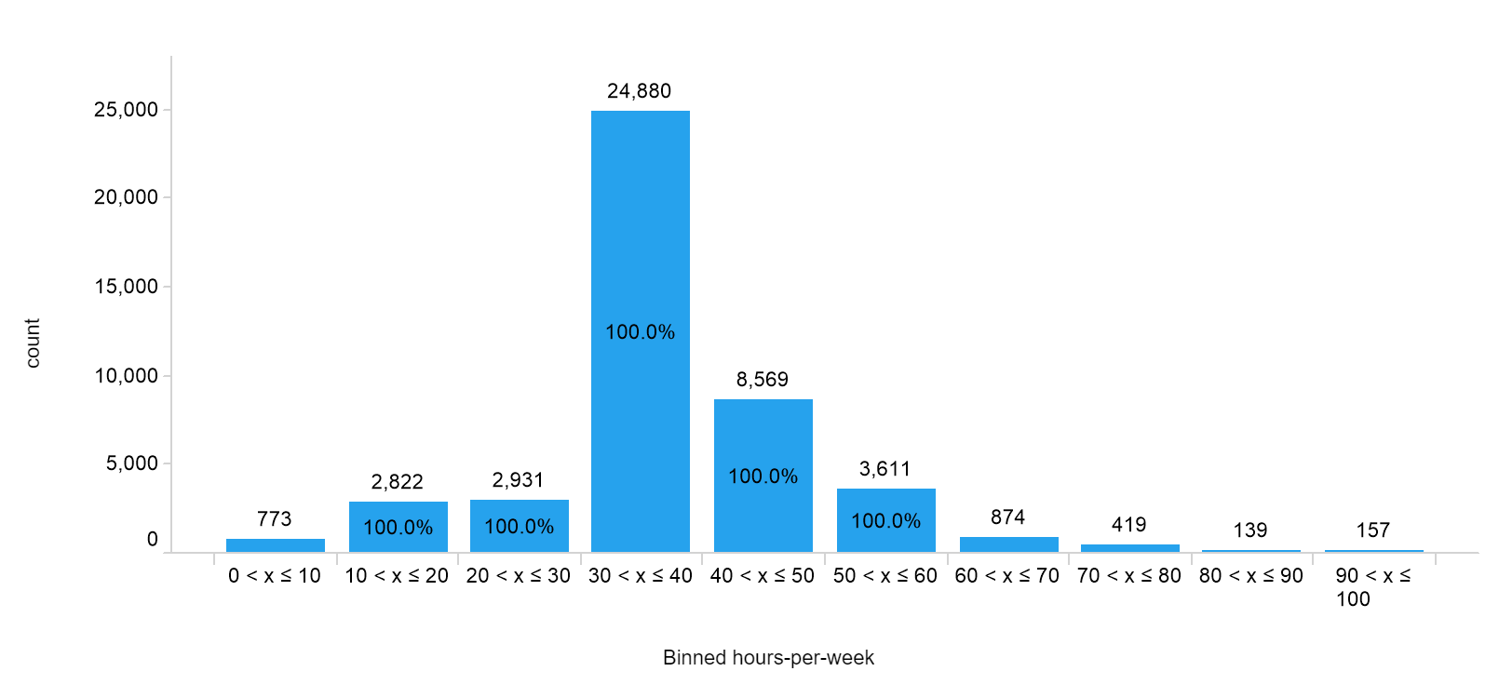
Hours Per Week Distribution

Slide 32
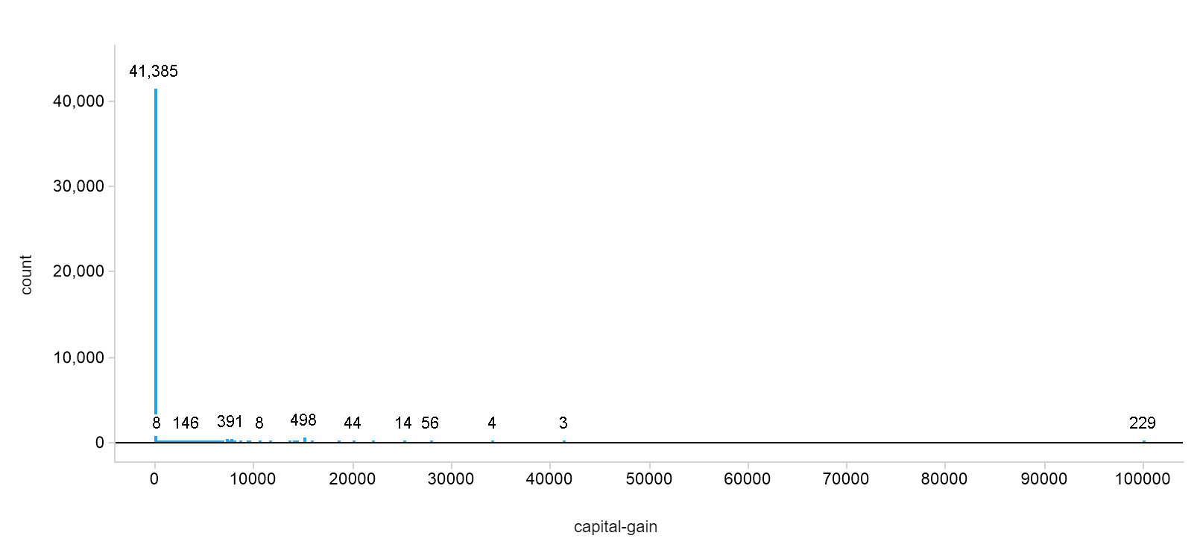
Capital Gain Distribution

Slide 33
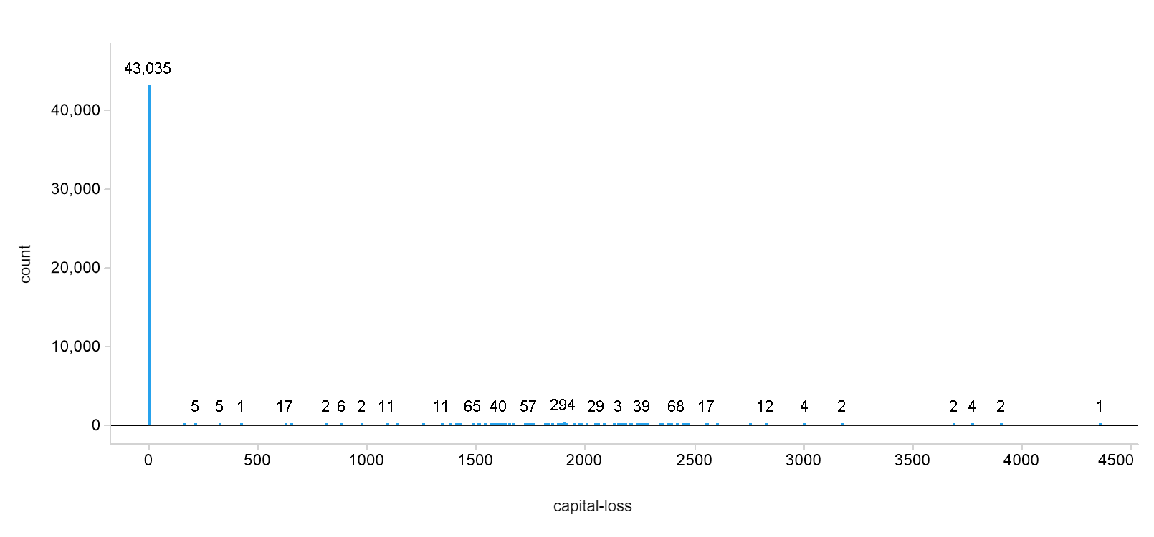
Capital Loss Distribution

Slide 34
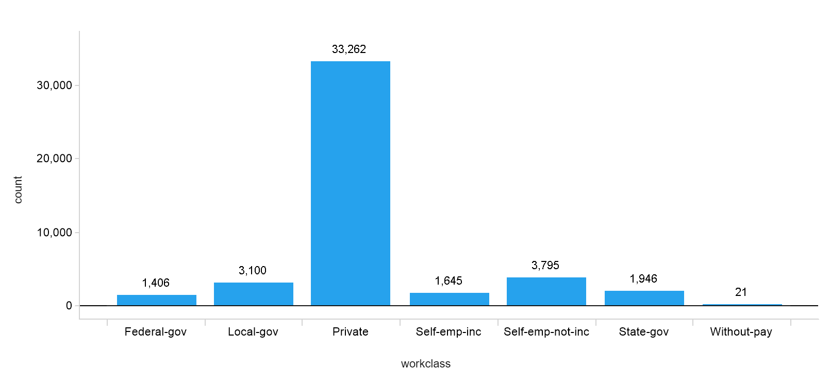
Work Class Distribution

Slide 35
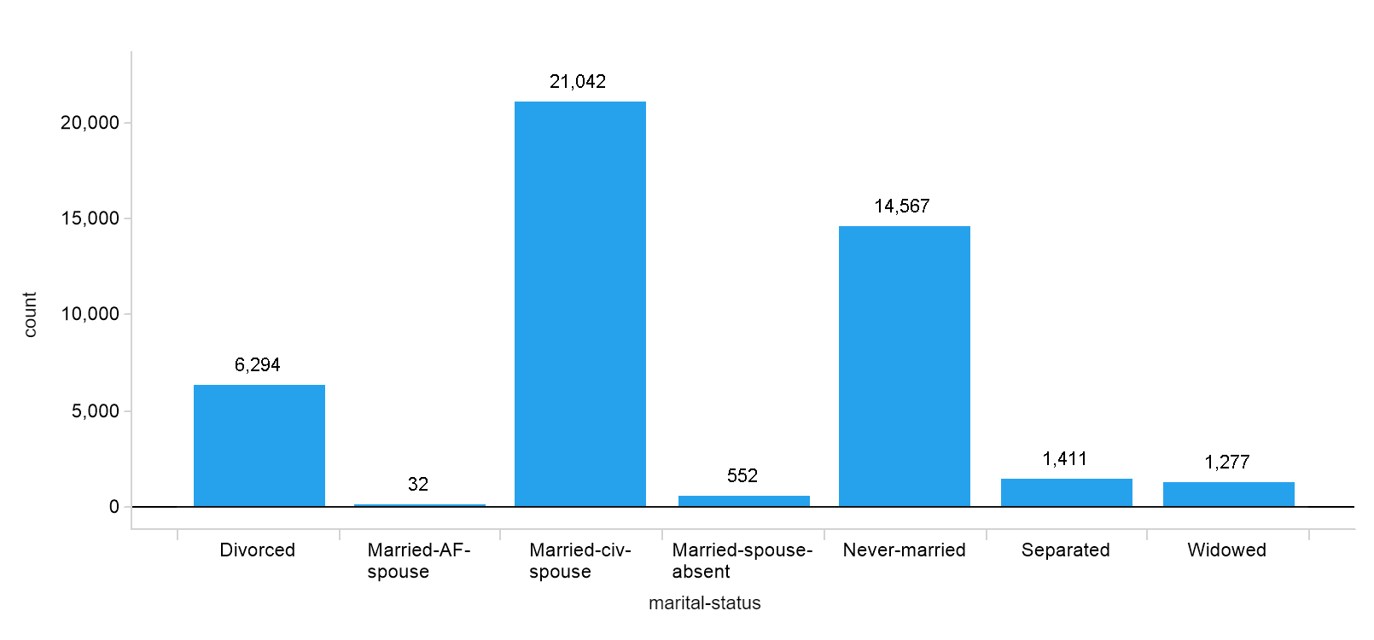
Marital Status Distribution

Slide 36
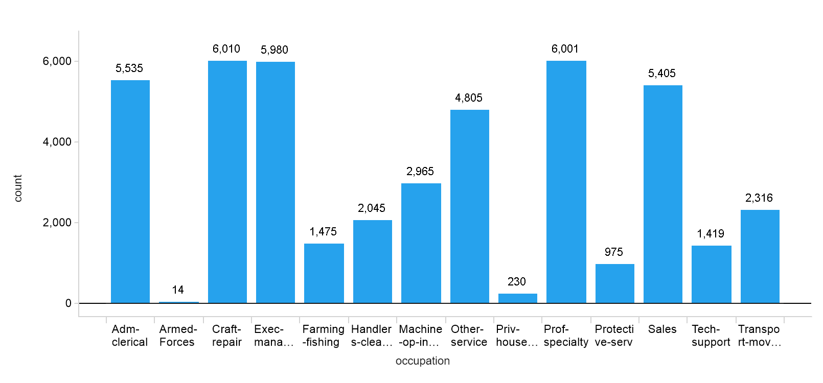
Occupation Distribution

Slide 37
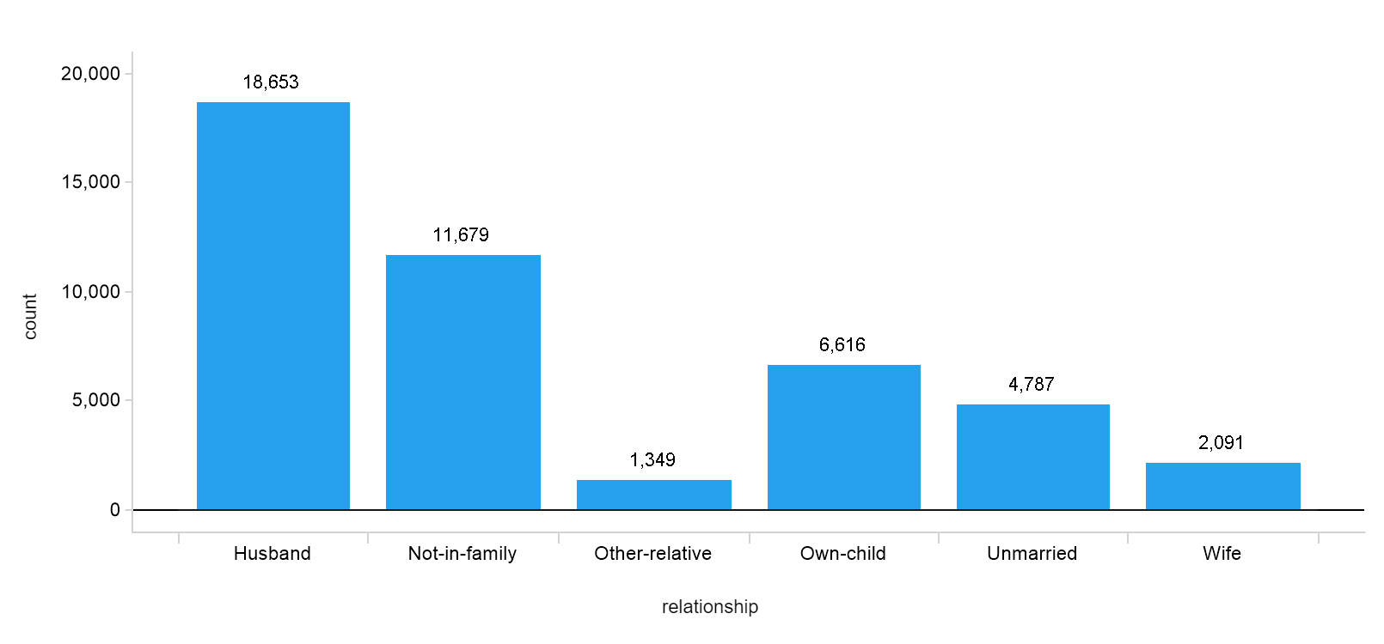
Relationship Distribution

Slide 38
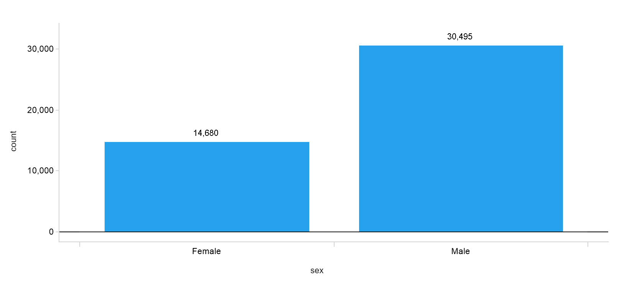
Sex Distribution

Slide 39
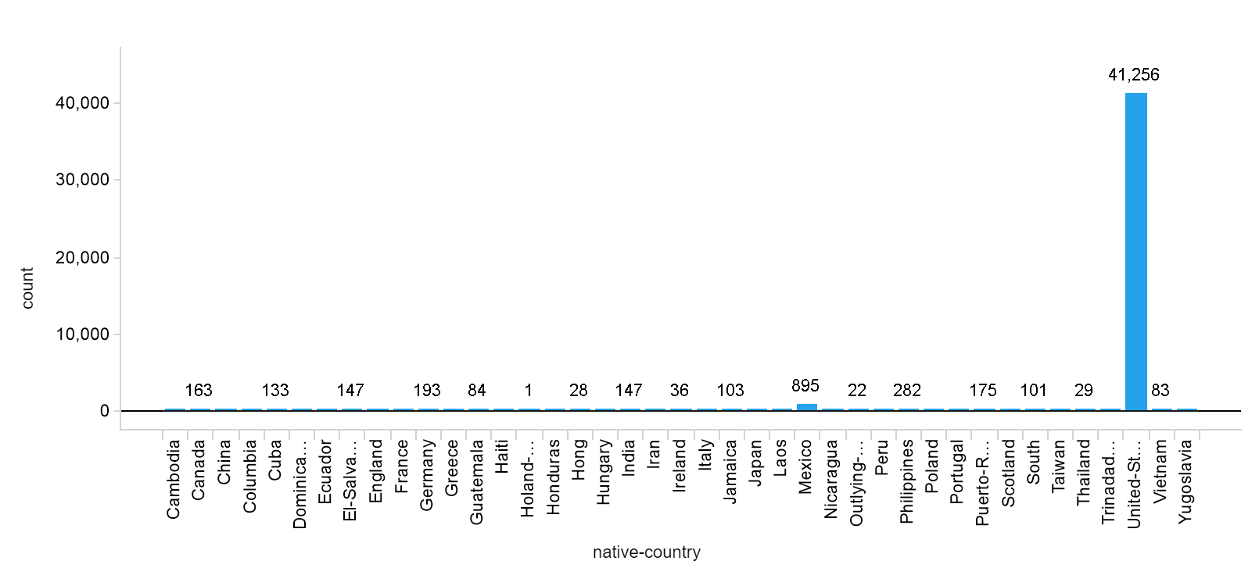
Country Distribution

Slide 40
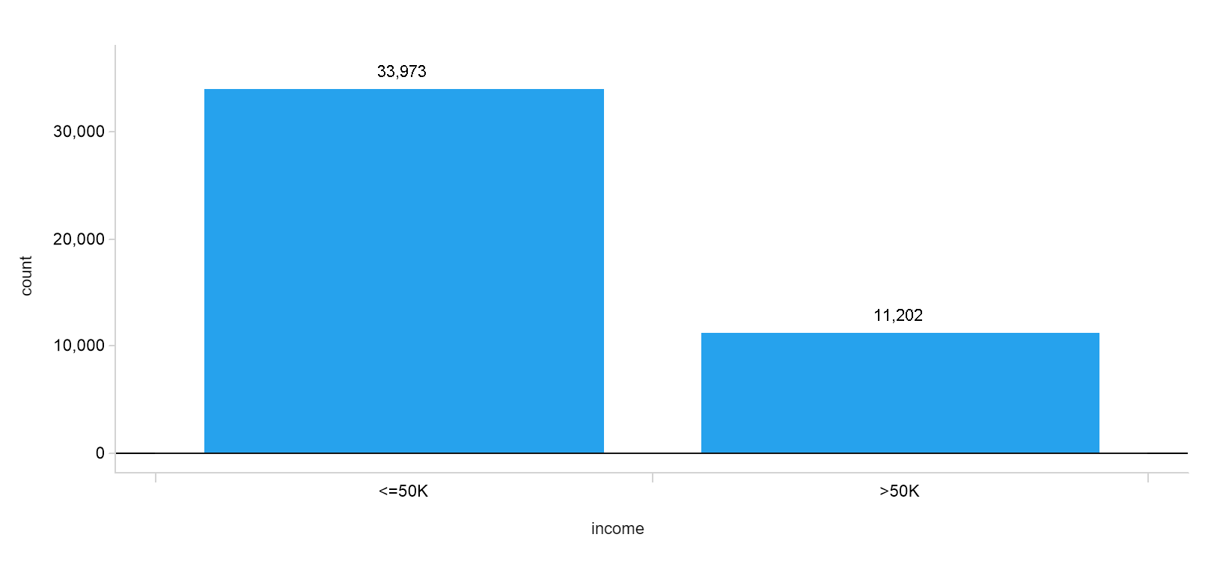
Income Distribution

Slide 41
Model Tuning Details
Tree
Maximum depth: [1, 2, 3, 4, 5, 6, 7, None]
Criterion: ['gini','entropy’]
Minimum samples leaf: [1,2,3,4,5]
Minimum samples split: [2,3,4,5]
Logistic Regression
C: [0.00001,0.0001,0.001,0.1, 1, 10, 100, 1000]
tol: [0.1,0.01,0.001,0.0001,0.00001]
fit_intercept: [True,False]
penalty: ['l1','l2']
K-NN
n_neighbors: [1,3,5,7,9,11,13,15,17,19,21],
weights: ['uniform','distance']

Slide 42
Confusion Matrix : Naïve Vs. Decision tree
Naïve Rule
Decision Tree
6798 | 0
2241 | 0
Out-of-Sample Accuracy: .75
Out-of-Sample Accuracy: .85
 | ≤ $50K | >$50K
Precision | 1 | 0
Recall | .75
F-Measure | .84
 | ≤ $50K | >$50K
Precision | .87 | .76
Recall | .94 | .57
F-Measure | .9 | .65

